Slide 1
2023
Engineering
Design
Week 1
Self
Introduction

Slide 2






Profile
Laboratory
Hallucination
Mental Health Chatbot
Sports
Interests

Slide 3
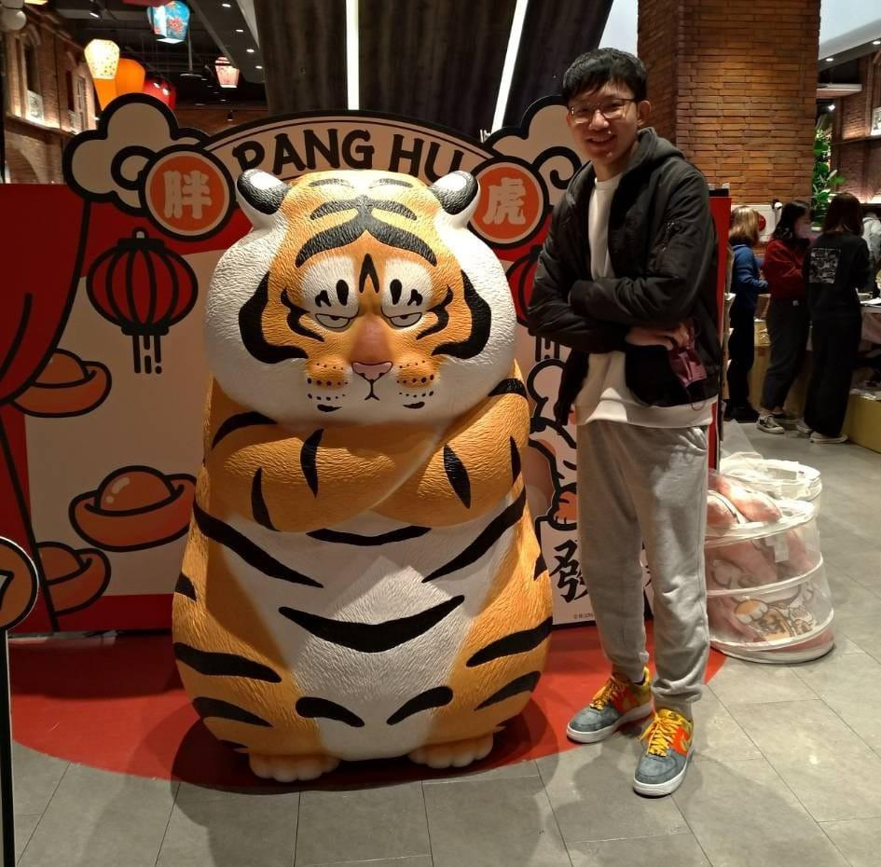
Name Po-Chuan Chen Major Electronics and Electrical Engineering

Slide 4
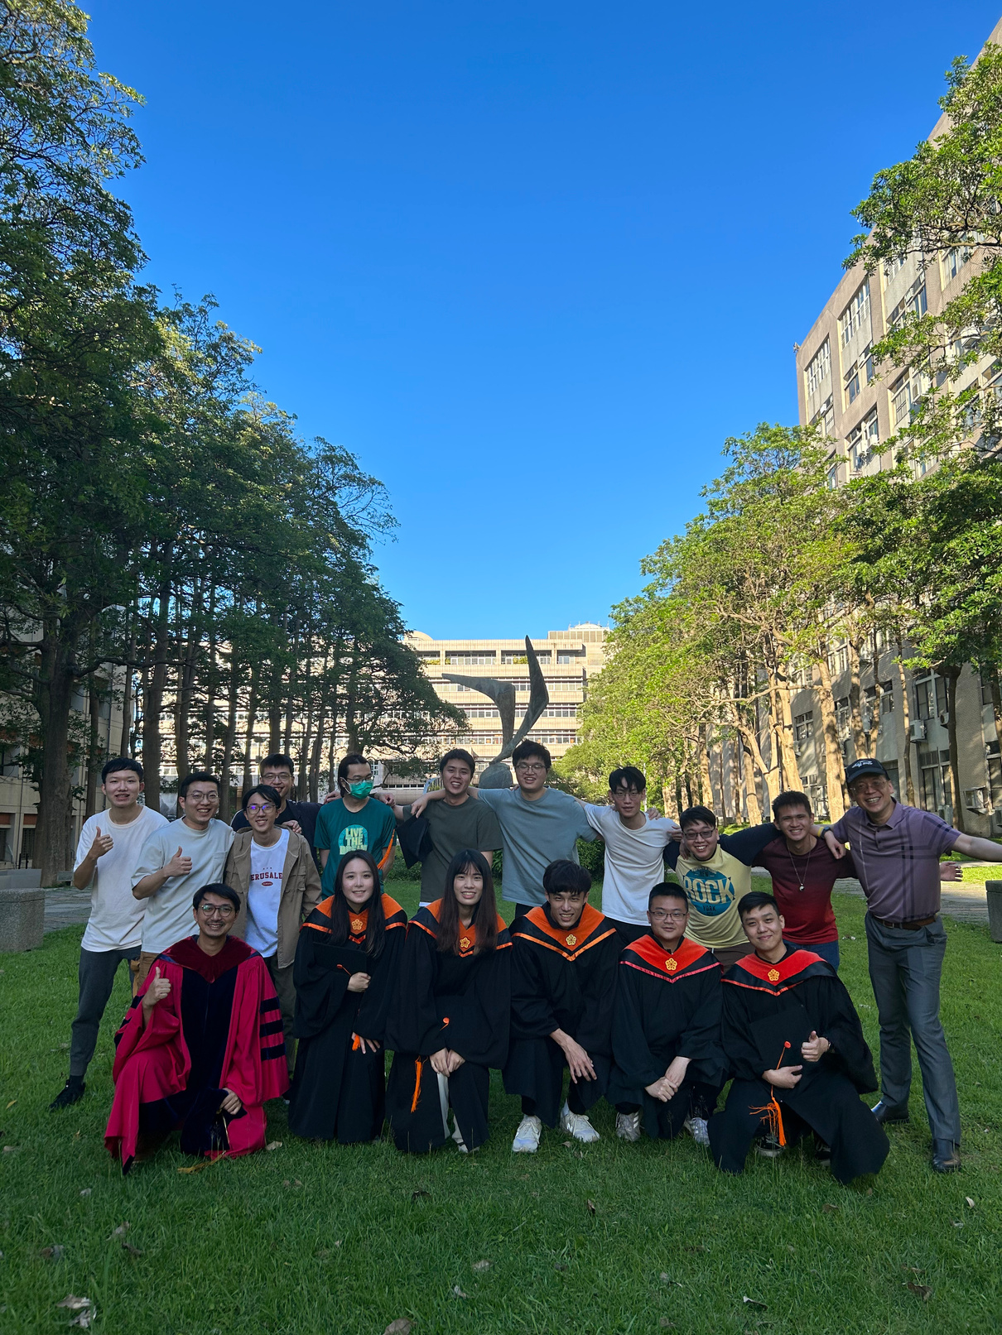
Laboratory Machine Learning
Computer vision
Natural Language Processing
Reinforcement Learning

Slide 5

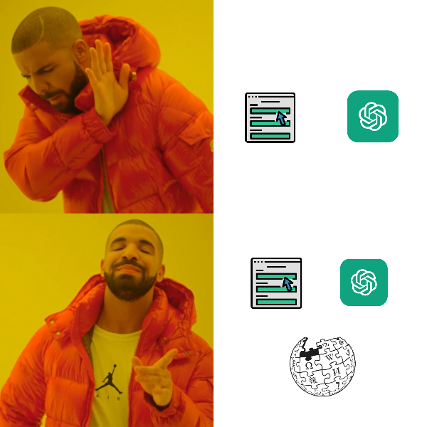
Retrieval Augment Generation
May generate the wrong answer but looks like it’s correct.
If we can retrieve some external knowledge, we may avoid this happening.

Slide 6







Mental Health Chatbot

Slide 7
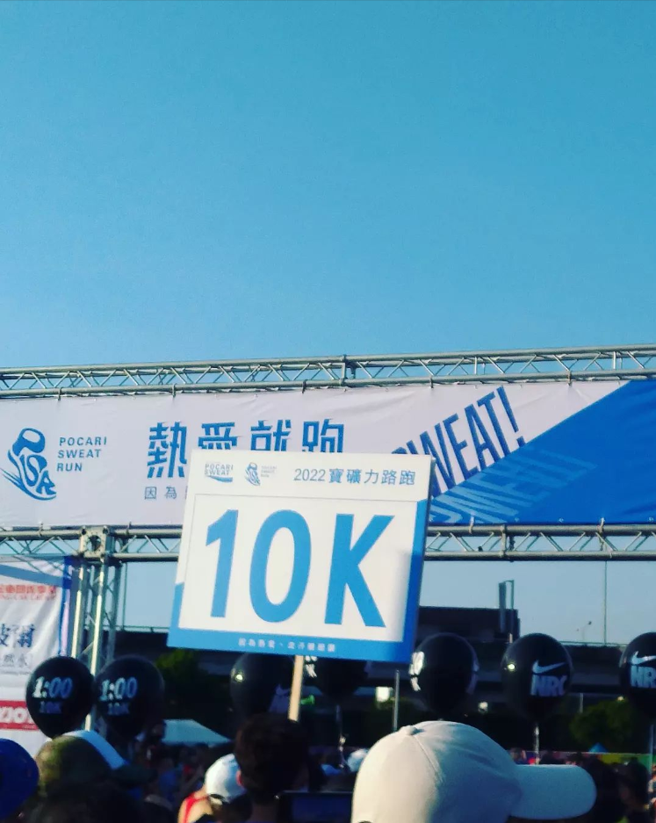
Sports:
Run
Workout
Basketball

Slide 8

Interests:
Travel
Photograph
Movie
Music
Blog
Interests:
Travel
Photograph
Movie
Music
Blog
Interests:
Traveling
Photograph
Movie
Music
Blogging

